Slide 1

Module 2: Data Visualization and Communication Principles of Data Visualization
Siddharth Sundar
MyAnatomy Integration
NCET Core Team

Slide 2
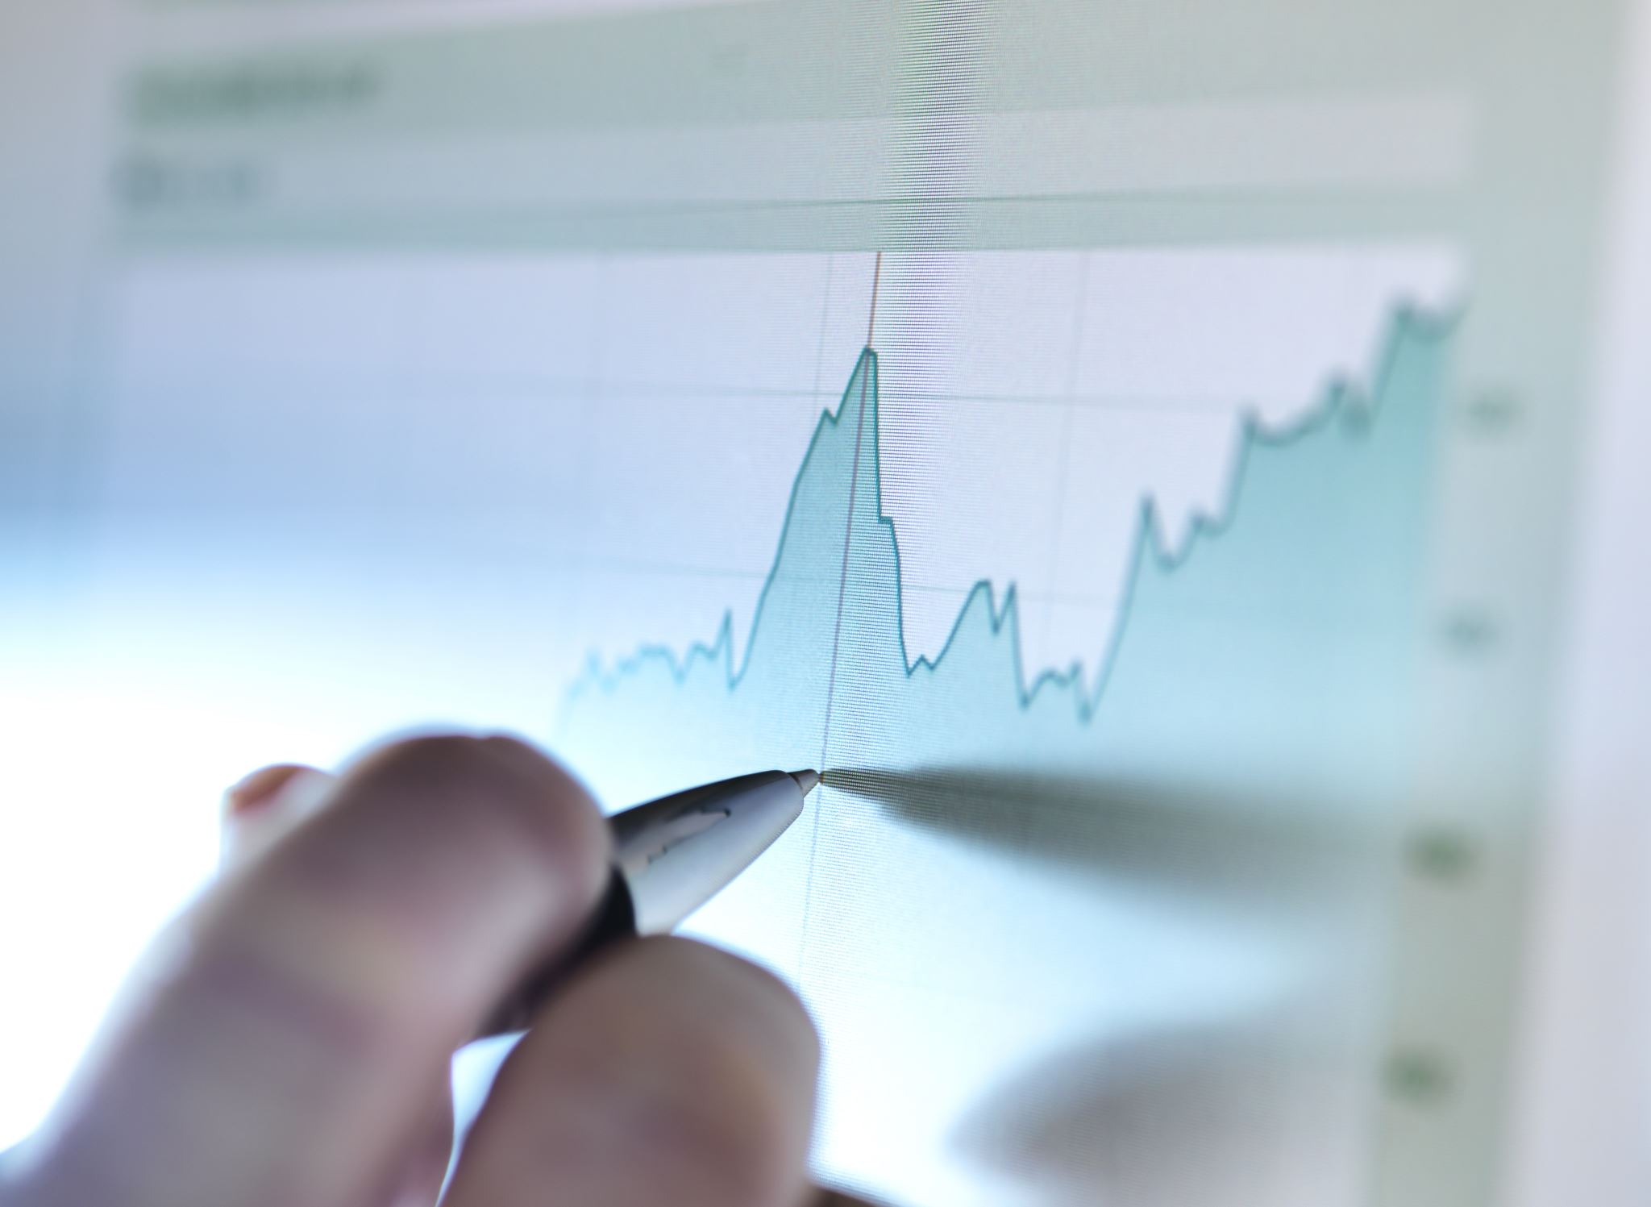
What is Data Visualization?
By Definition, “The Representation of Data in the form of Charts, Diagrams, or Pictures is called Data Visualization.”
Creating visual representations of data is a very important component of Data Communication.
People don’t want to see excel sheets and raw data sets, they want to see graphs and charts that they can understand with just a quick glance.

Slide 3
What is Data Visualization?
Name | Gender | Genre | Shows in a Month | Approximate Net Worth | Region
Akash Gupta | Male | Observational | 82 | 41814919 | North
Anubhav Singh Bassi | Male | Improv | 44 | 48298556 | North
Kenny Sebastian | Male | Observational | 71 | 36705222 | South
Shraddha Jain | Female | Satirical | 91 | 28586913 | West
Sumukhi Suresh | Female | Observational | 33 | 30313797 | South
Pragati Sinha | Female | Satirical | 40 | 31132594 | West
Abishek Upmanyu | Male | Observational | 49 | 7887330 | North
Biswa Kalyan Rath | Male | Observational | 34 | 36626597 | East
Bharti Singh | Female | Satirical | 27 | 47348290 | West
Kannan Gill | Male | Dark | 94 | 25167611 | South
Sugandha Mishra | Female | Dark | 92 | 24427869 | East
Aishwarya Mohanraj | Female | Improv | 80 | 33586724 | South
Abish Matthew | Male | Improv | 78 | 41415716 | South
Neeli Palta | Female | Improv | 58 | 15840710 | East
Urooj Ashfaq | Female | Improv | 43 | 28477462 | North
Anuradha Menon | Female | Observational | 86 | 17614810 | South
Aditi Mittal | Female | Satirical | 65 | 27489247 | East
Azeem Bantawalla | Male | Satirical | 18 | 19221575 | East
Ravi Gupta | Male | Satirical | 52 | 28115260 | North
Chockalingam | Male | Observational | 81 | 24096498 | South
Samay Raina | Male | Dark | 91 | 35104585 | North
Mohit Morani | Male | Improv | 92 | 26819409 | East
Mallika Dua | Female | Improv | 70 | 18461704 | West
Radhika Vaz | Female | Observational | 78 | 6982385 | North
Look at this dataset.
Just by looking at it, it is difficult to understand what the data is trying to tell us.
We cannot communicate effectively just by showing spreadsheets.

Slide 4
Lets Visualize the Same Data

Slide 5
Lets Visualize the Same Data

Slide 6
What Changed?
By Visualizing the sheet, we were easily able to understand and infer multiple insights just by looking at the data.
Top stakeholders of companies like CEOs, and CFOs, often ask for reports from management that contains pure visualizations and redirections to datasets, as they do not have time to see each and every individual data point.
Using visualizations, we can communicate data effectively and efficiently.

Slide 7
What Visualizations Can We Use?
Now comes the next question, What Types of Visualizations can we use?
There are 3 popular categories of Visualizations:
Graphs – For showcasing trends over a period of time.
Charts – For comparing different categories of values.
Maps – For depicting spatial data.
Let us look at individual visualizations with use-cases and examples.

Slide 8
1) Bar Graph
Graphical Representation using Rectangular Bars
Used for Comparing different categories or groups.
Example –Customer Preferences breakdown, Sales Revenue, etc.,

Slide 9
2) Pie Chart
Graphical Representation using “Slices of a Pie”
Used popularly to show percentages of a whole.
Example – Percentage of Market Share Held by a Company, Breakdown of Gender, etc.,

Slide 10
3) Line Graph
Graphical Representation using “Lines”
Used popularly to show trends over time.
Example – Stock Market Prices going up/down, Sales of a Company, etc.,

Slide 11
4) Scatter Plots
Graphical Representation on a 2-Dimensional Plane.
Used popularly to show relationships between variables.
Example – Advertisement and Sales Revenue, Stock Market and Market Index, etc.,

Slide 12
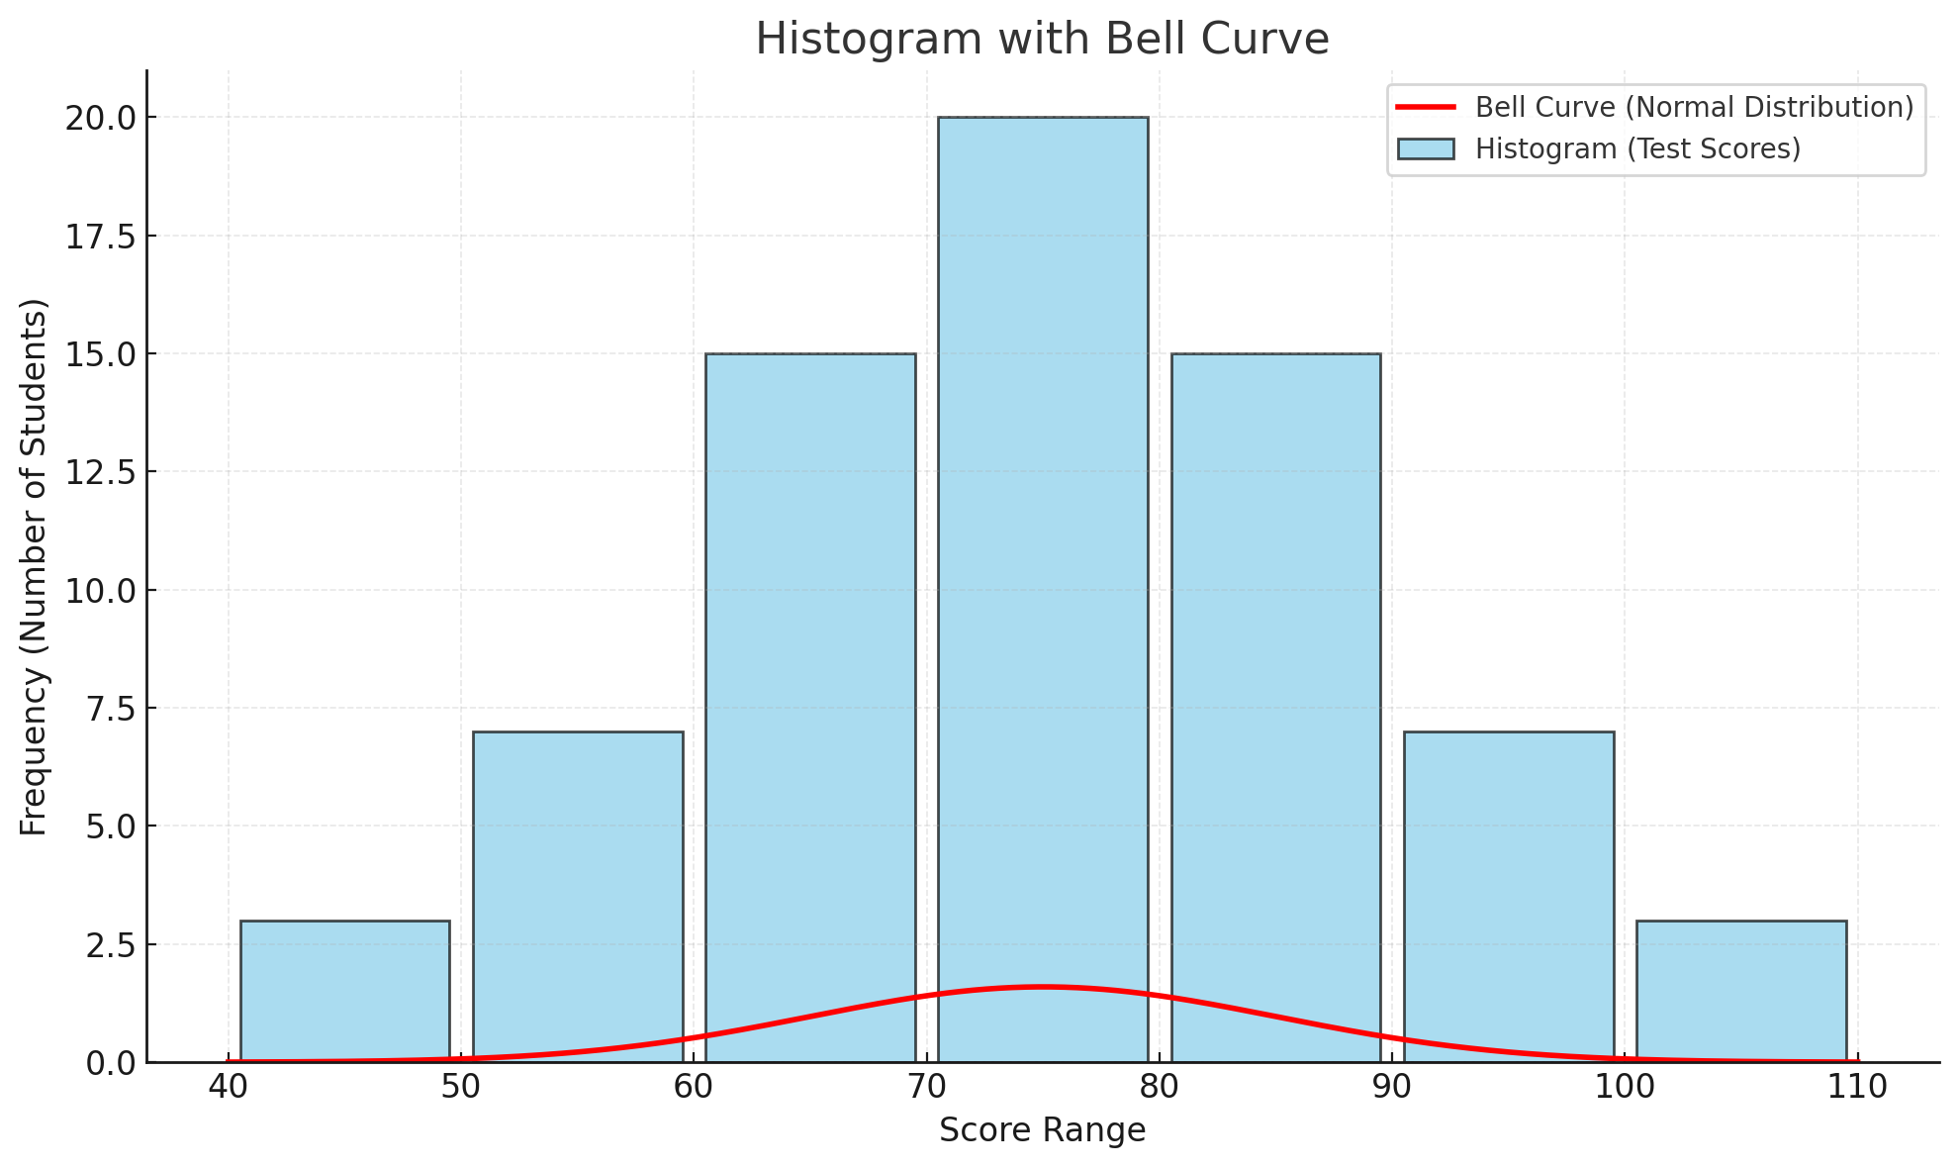
5) Histogram
Graphical Representation using Bars and Curves
Used popularly to show the distribution of data.
Example – Distribution of Test Scores, Distribution of Height, etc.,
Basically, if the curve is Skewed to the left, it means many people are in the first half, if it is Skewed to the right,
it means many people are in the second half, if it is in bell shape, then the data is “Normally Distributed”

Slide 13
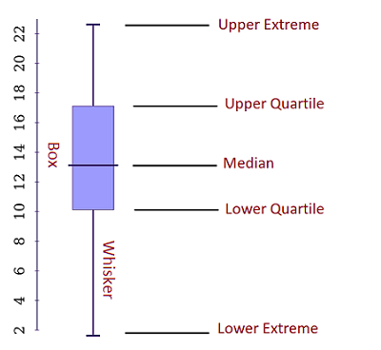
6) Box and Whisker Plot
Graphical Representation to summarize data using Medians, Quartiles, and Outliers.
Popularly used for multi-statistic comparison
Example – Compare Employee Salary across different Departments, etc.,

Slide 14
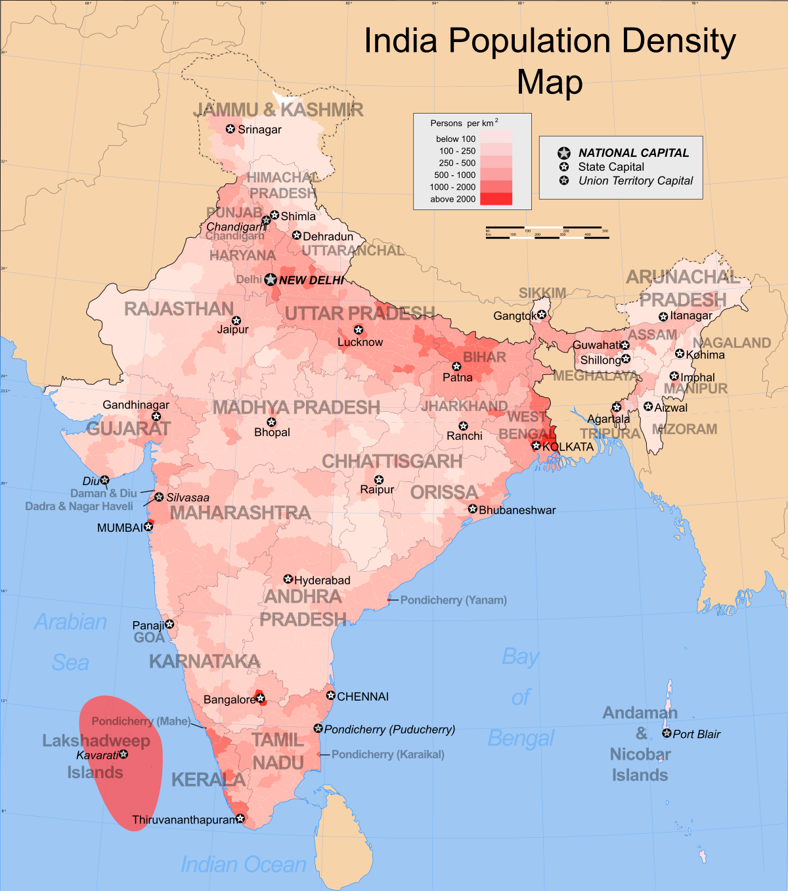
7) Heatmaps
Graphical Representation using Colors.
Used popularly to represent the intensity of data.
Example – Population of Data represented by Colours.

Slide 15
Other Maps
Most of data communication is covered using the aforementioned visualizations.
However, there are other popular variants like Pyramid Charts, Funnel Charts, Area Maps, etc., that are also used for data communication.
For the purposes of this course, our focus will purely be on understanding these visualizations, and using them in appropriate places for data communication and storytelling.

Slide 16

Thank You
Q & A

